Slide 1

Computer System
By Jesus Mendez

Slide 2
Components
There is 6 main components
Motherboard
CPU
GPU
PSU
Ram
Memory

Slide 3
connectors
Inner connectors
24-pin ATX
4-8 pin CPU
Sata
PCI-e
Ect...
Peripherals/ outer Connectors
Mouse
Keyboard
Ethernet

Slide 4
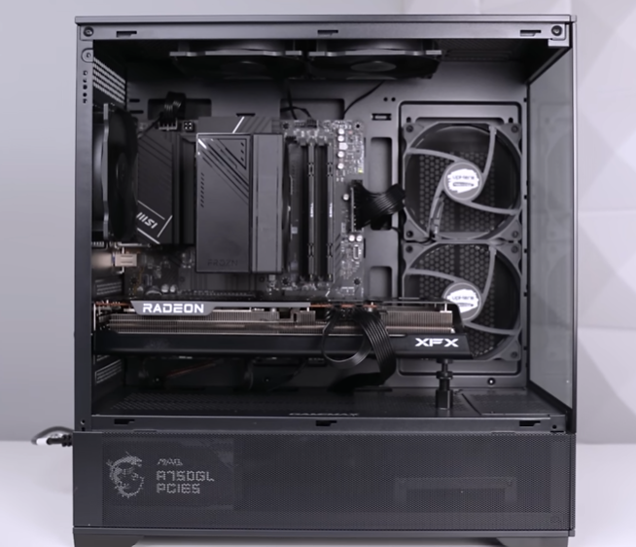

Slide 5
Trouble shooting
Many issues may arise on systems
Hardware - components may damage overtime
CPU
GPU
PSU
Motherboard
Connections
Dim slot
PCI-e slot
software – factors to systems function
Corrupt
storage
Outdated
Drivers
Conflicts
Combability
Software is generally easier because you are given error messages with error codes which and be looked up whist hardware must be pinpointed by trial and error

Slide 6
Software
There are a verity of important software
Windows/MacOS/Linux operating system
GeForce, AMD etc.… for GPU drivers
Firmware
Virtual machines
If networking
Nmap etc.. For visual network connection
Command line

Slide 7
networking
What is networking – connection between systems by router/modem
Networking systems may be comprised of
Modem
Router
Computers
Mobile devices
Printers
servers

Slide 8
